Slide 1










De﻿mographic Changes In Germany
SEABORN SEEDS | DATA ANALYTICS | SPICED ACADEMY
WALID JAN MIAKHEL

Slide 2



Contents
Population Size
Fertility Rate
Gross Domestic Product
Demographic
Changes
Conclusion
Age Distribution
Life Expectancy
Immigrants

Slide 3


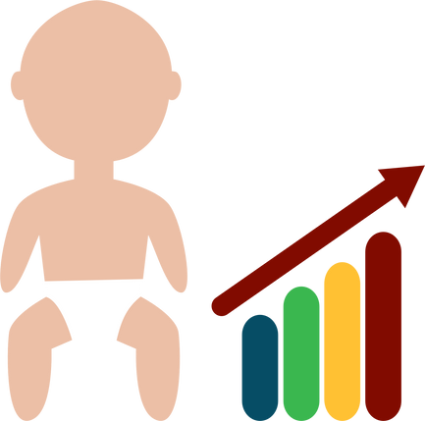



Demographic Changes
Why Demographic changes are important?
Population Size
Age
Economy :
Shrinking workforce
labor shortages, rising wages
Aging population
Strain on government finances
Social fabric :
Immigration can lead to cultural diversity
Birth Rate
Death Rate
Environment :
The growing population can put pressure
on natural resources
Migration

Slide 4



Population
Size
Gender Distribution
50 m
More equal or Less equal?
40 m
41.5 m
49.3 %
42.8 m
50.7 %
DECEMBER 2022
84,3 m
30 m
20 m
10 m
0 m
Male
Female
Source: Federal Statistical Office Germany

Slide 5
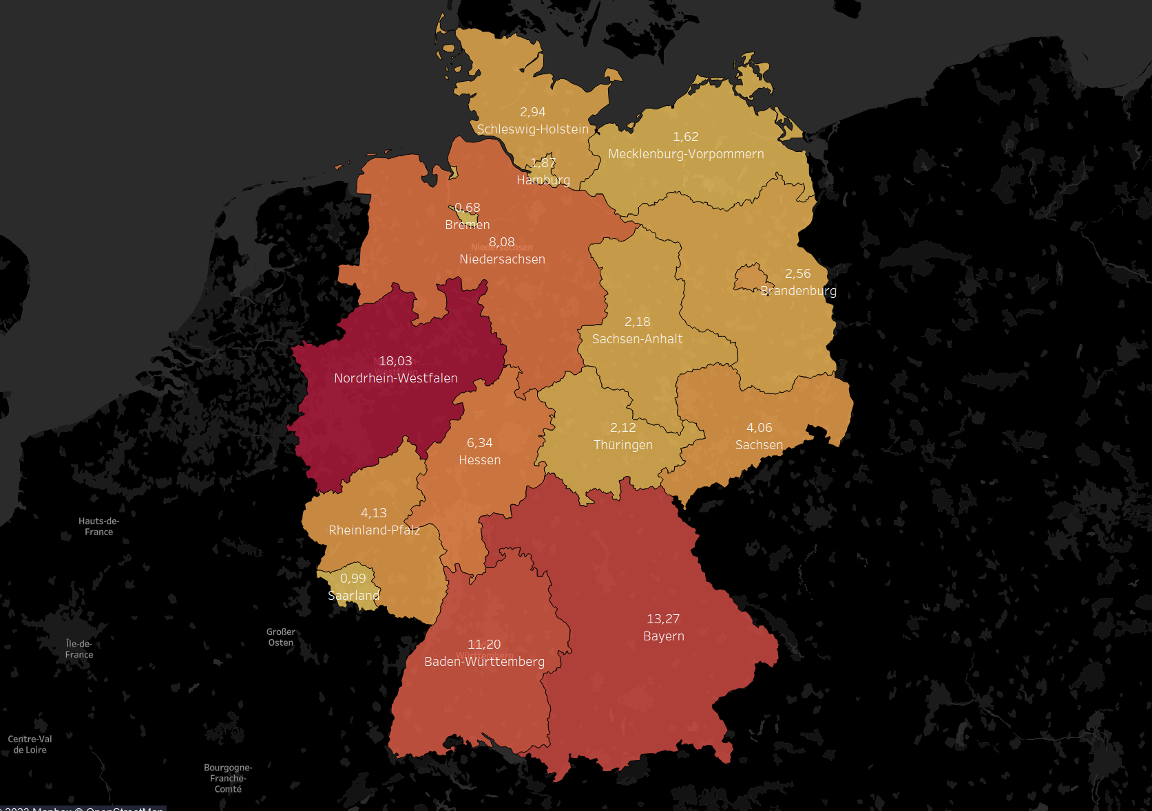
Population Statewise
3.72
Berlin
Source: Federal Statistical Office Germany

Slide 6
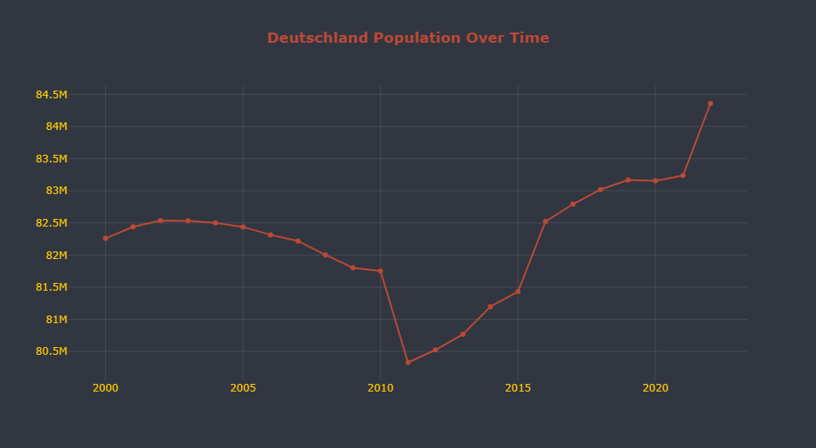
Is the population growing, shrinking, or staying the same?
Source: Federal Statistical Office Germany

Slide 7

In 2011, almost 1.5 million people
disappeared from the
population statistic
Population growth
due to increased immigration
81.75 m
Declining population
due to demographic changes
80.32 m

Slide 8
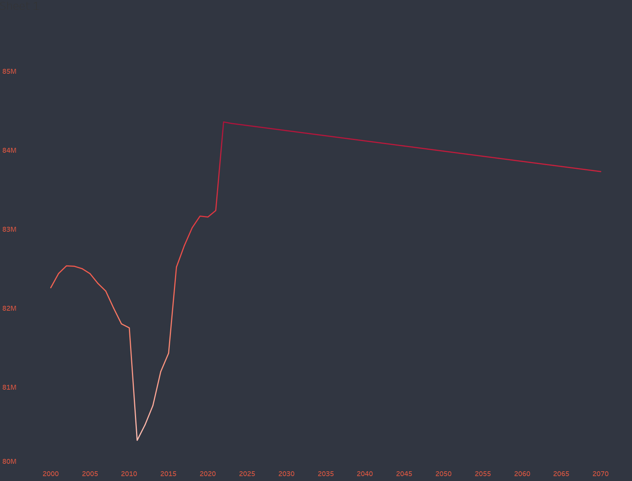
Population Projection 2070
84.3 m
83.7m
Assuming high number immigration

Slide 9



Age Distribution
60 m
56.9 m
~67.6%
40 m
To better understand the population and workforce.
Let's divide age into:
1. Nonworking age ( 0-14, 67+ )
2. Working age ( 15 - 67 )
15.5 m
18.3 %
20 m
11.9 m
14.1 %
0 m
0-14
15-67
67+

Slide 10
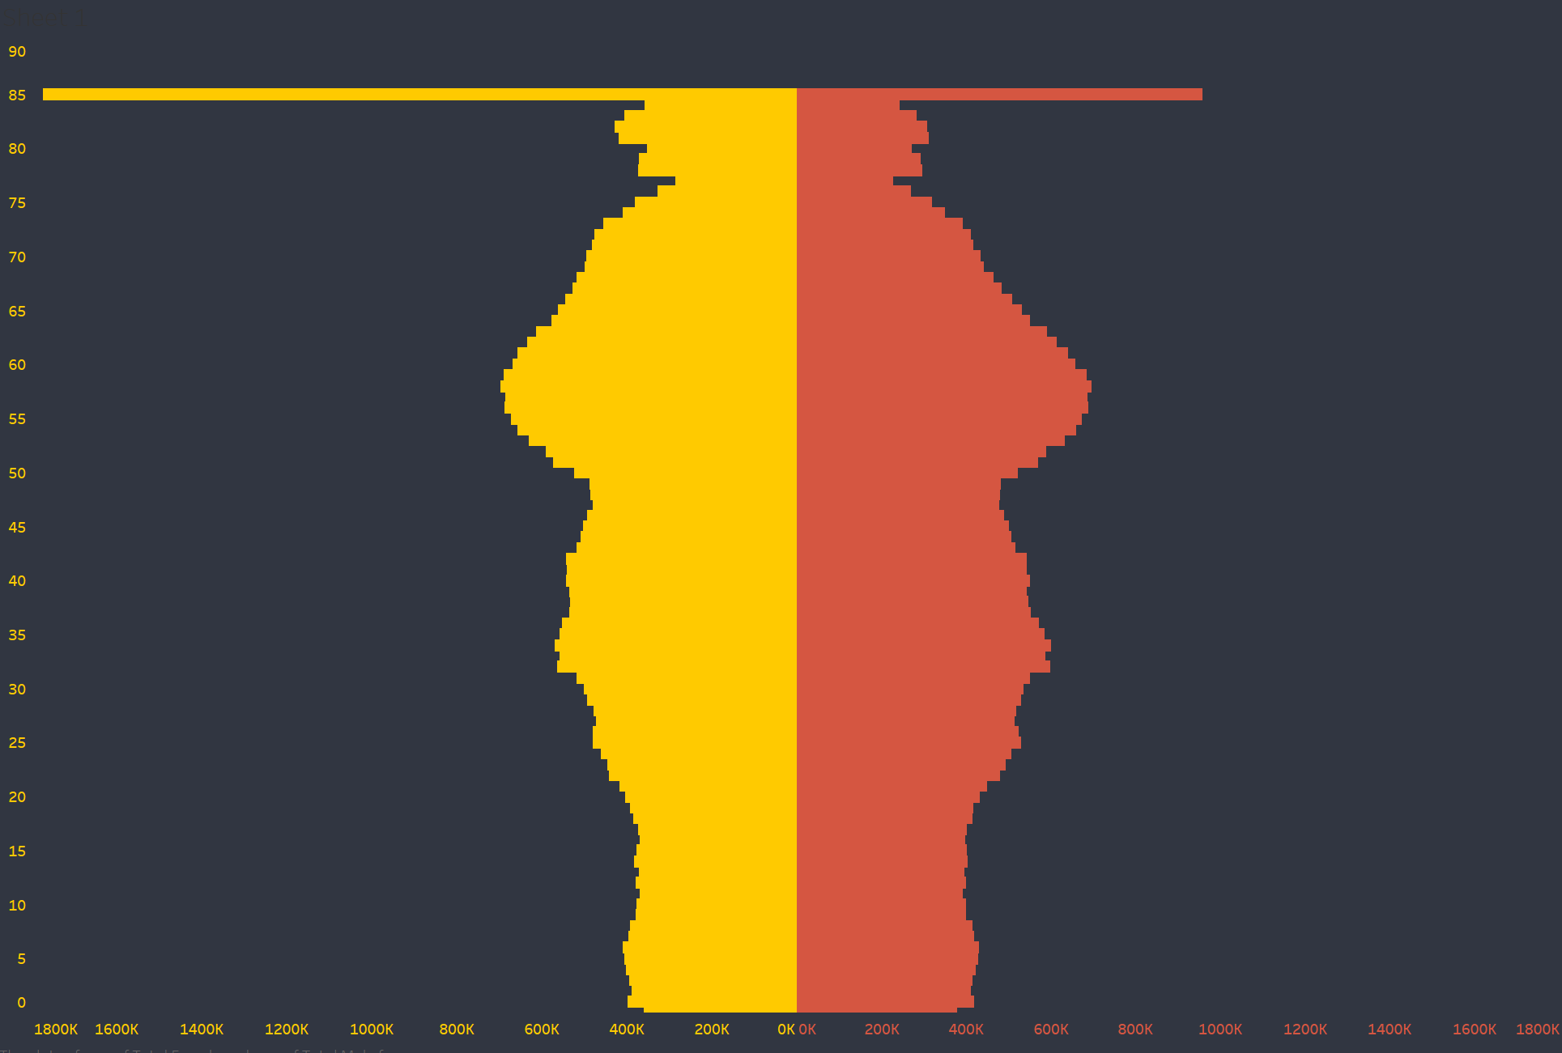



Population Distribution
by Age & Sex
Population bubble
nearing retirement

Slide 11
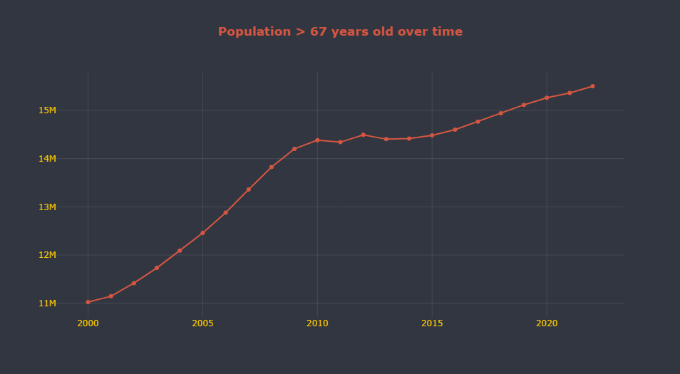

15.5 m
15.36m
since 2021
by 0.9 %
since 2000
by 41 %
Is it getting older?

Slide 12
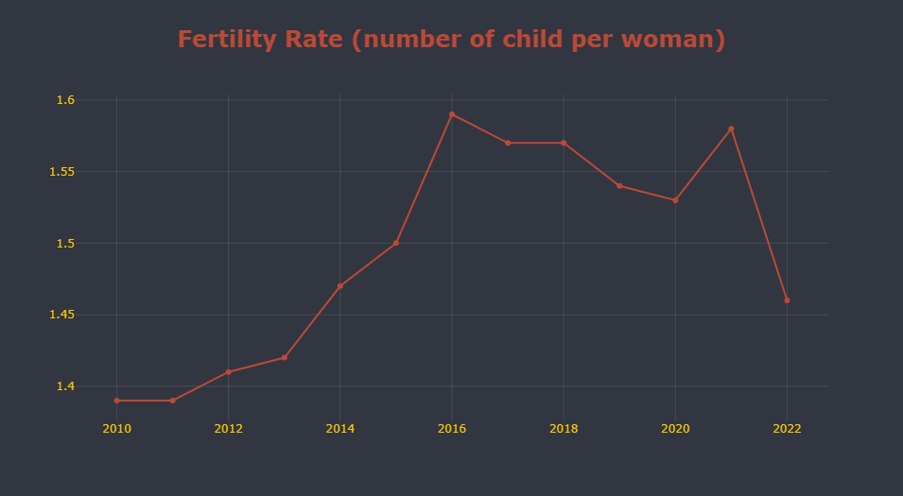
Fertility Rate
2010 -2022
1.59
1.58
1.57
1.57
1.54
Due to immiggration
1.53
1.5
1.47
women wanted to do COVID vaccinations
1.46
1.42
1.4
1.3
1.3

Slide 13
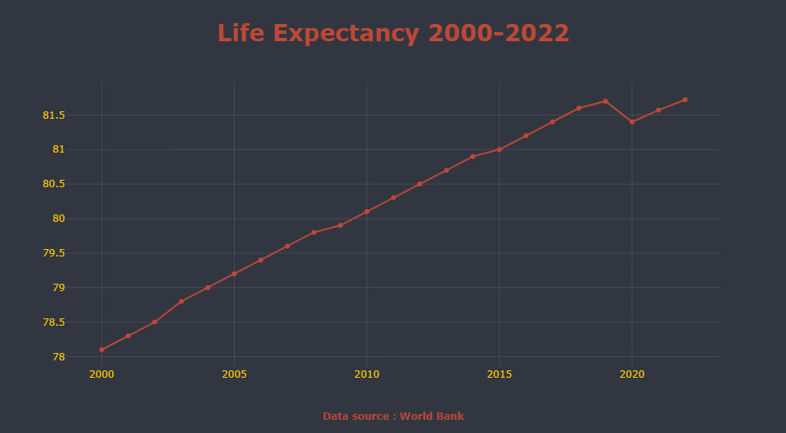

81.7
81.7
81.4
since 2000 increased:
3.6 year
4.7 %
High life expectancy :
Can lead the population towards older ages
78.1

Slide 14
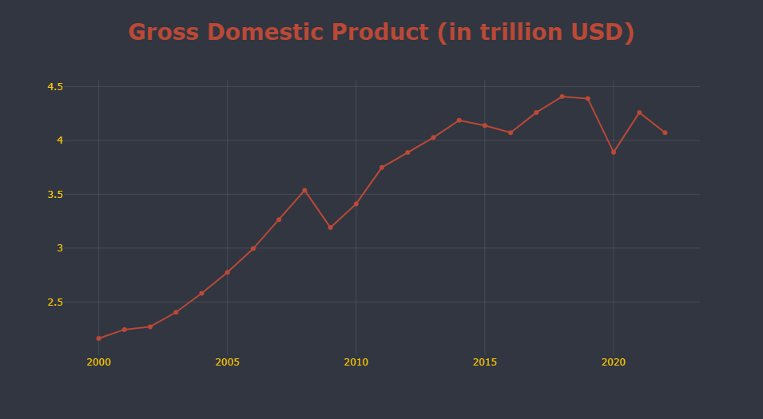
In trillion USD
4.38
4.07
3.88
3.53
3.19
COVID 2019
Global financial Crisis
2008 - 2009

Slide 15
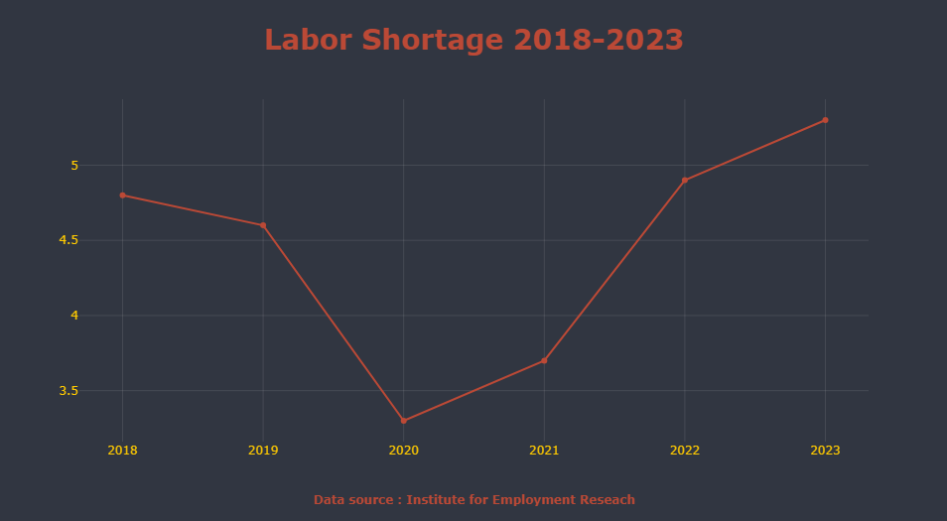
0 No labor shortage
10 High Need of Labors

Slide 16
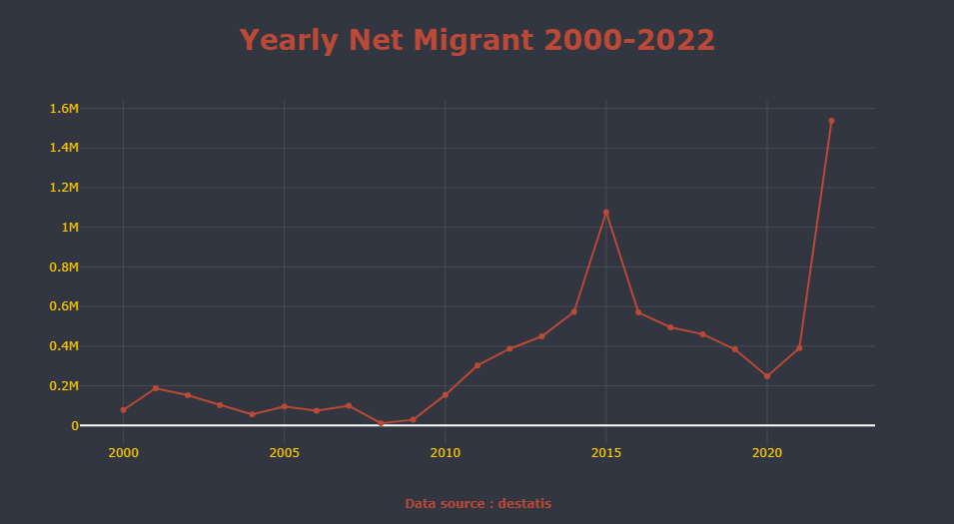

1.53 m
1.07 m
Europe Migrant crisis
UkraineWar
Afghanistan
regime change
Government Policies
Syria Civil War

Slide 17
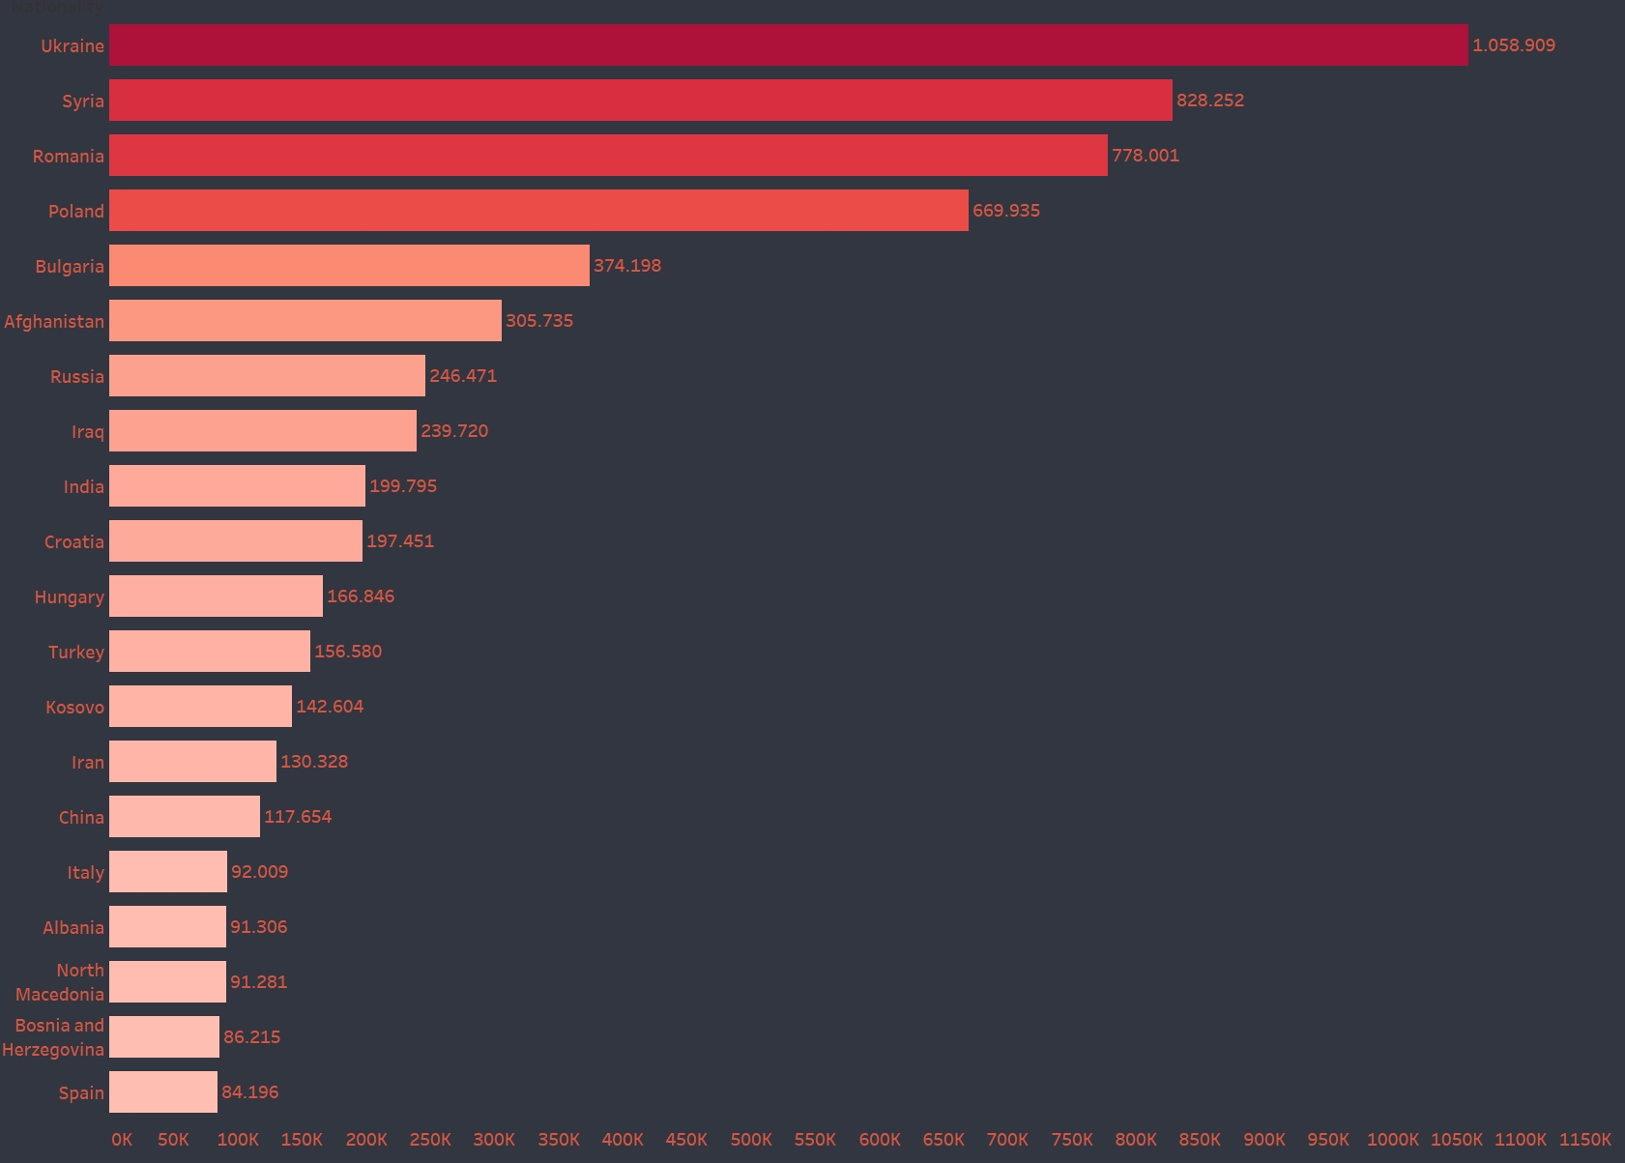
Top 20 Immigrant Countries since 2000

Slide 18
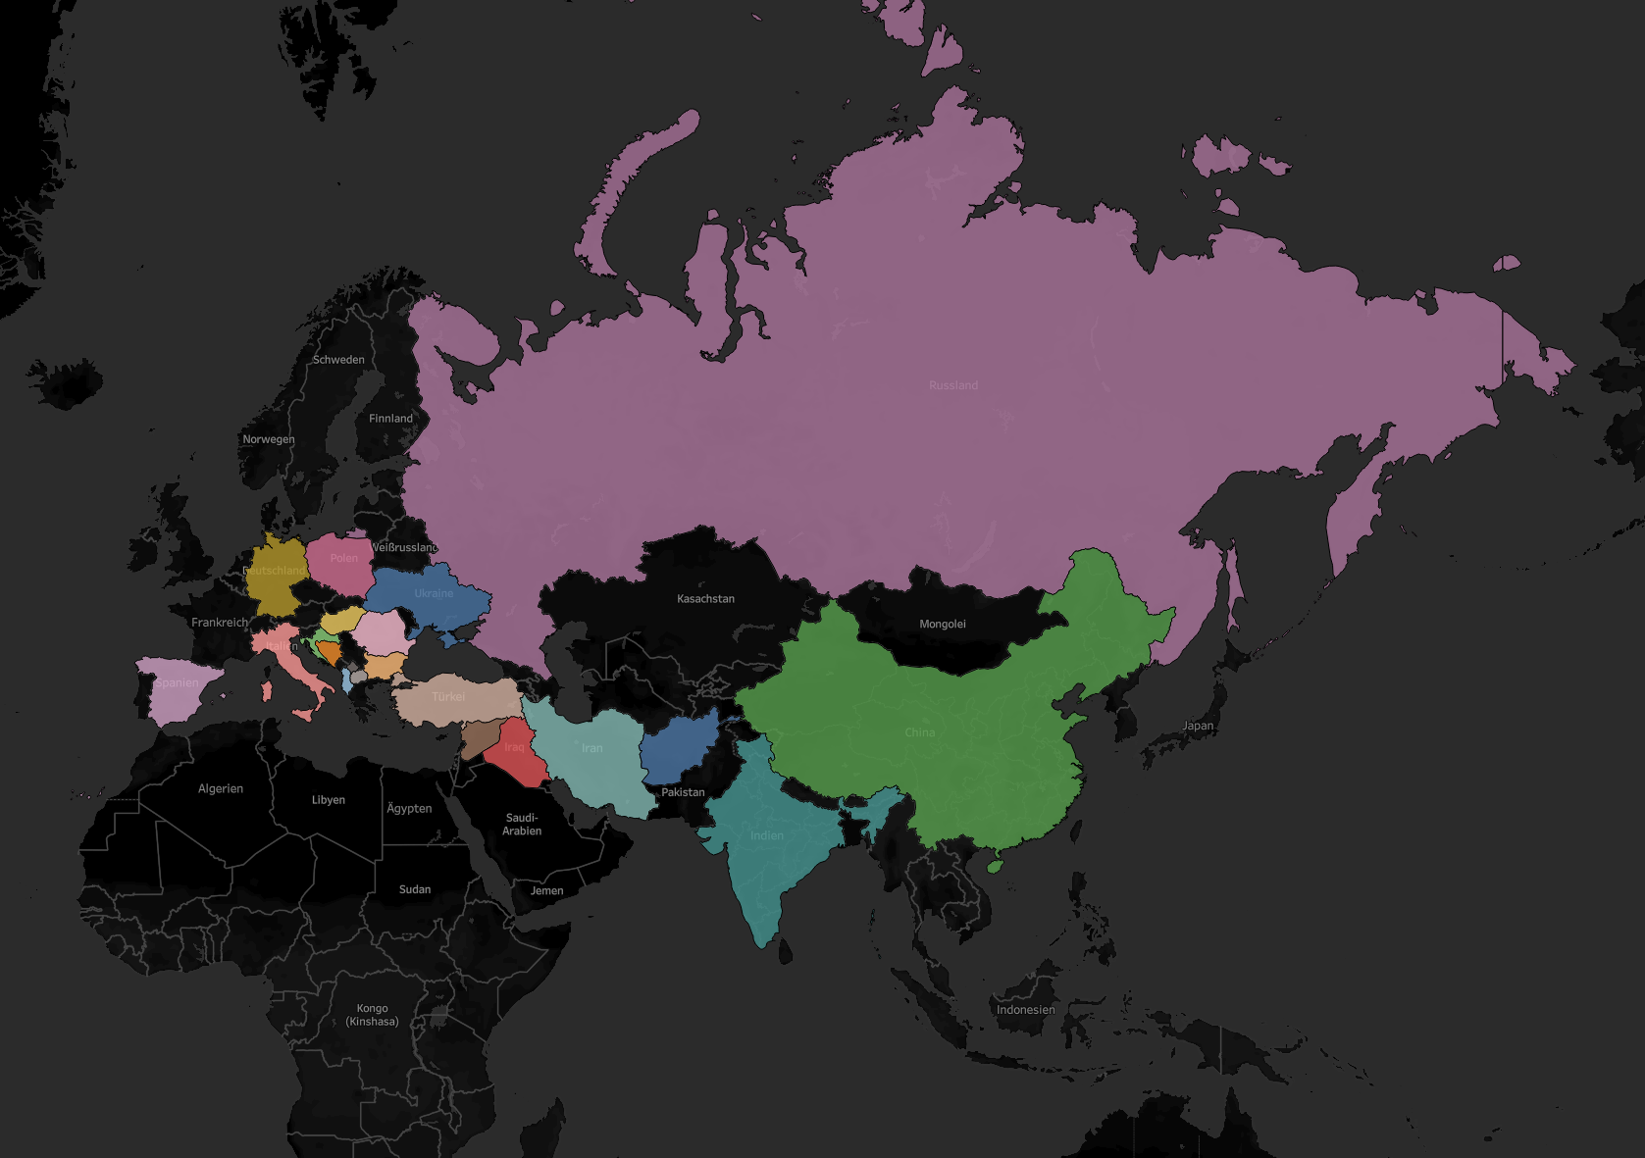


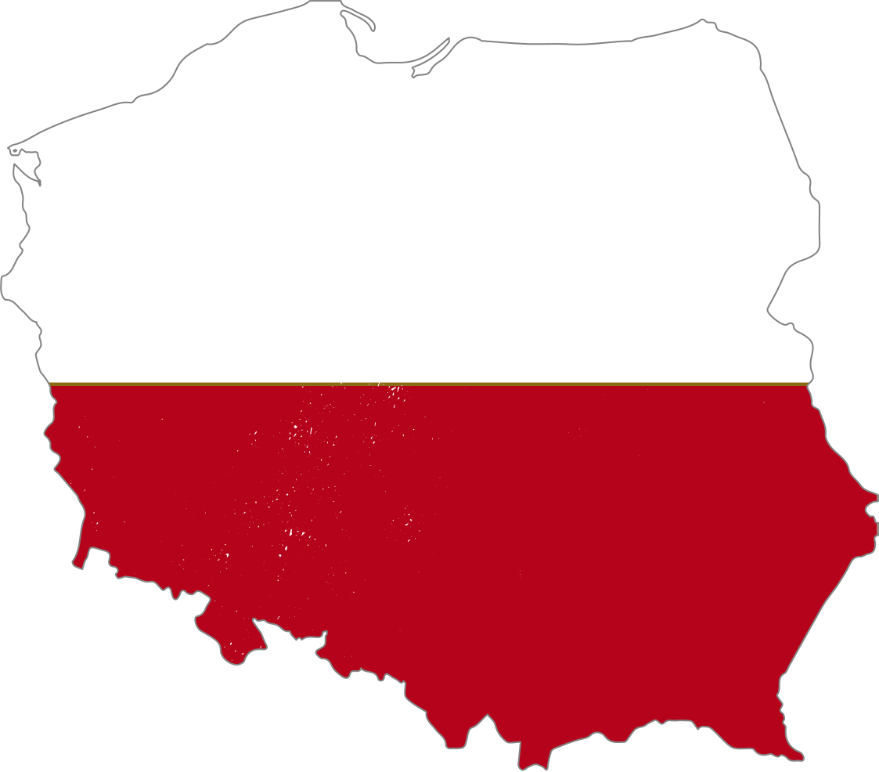
















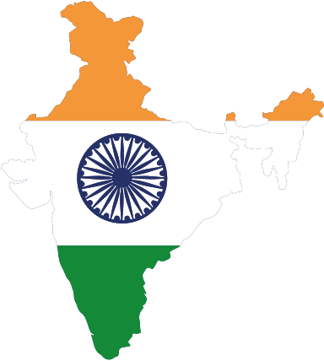

Immigrants From Top 20
countries since 2000

Slide 19

Conclusions
As we have seen Germany is facing the below challenges :
1. The aging population
2. low fertility rate
3. high life expectancy
4. labor shortage

Slide 20
Recommendations
Attract more immigrants.
Increase the retirement age.
Invest in automation and technology.
Promote a culture of lifelong learning.
Balance fertility rate.

Slide 21

Thank You

